Slide 1

Summary
PRAGMA Steering Committee Meeting
25 March 2009

Slide 2
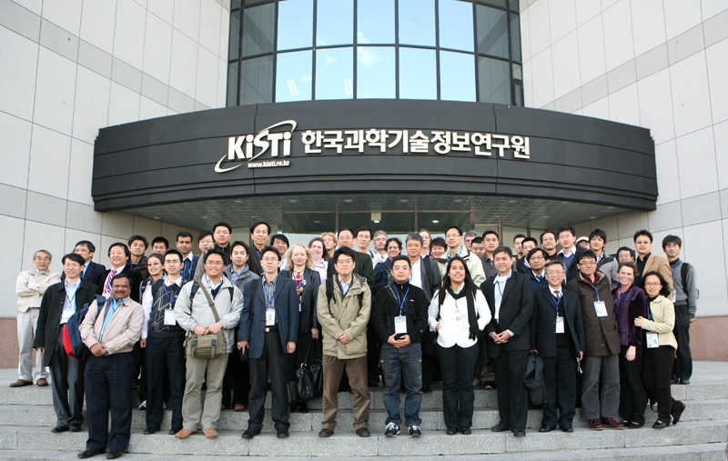

Slide 3
Special Thanks
PRAGMA 16 Program Committee
Kum Won Cho, (Chair PRAGMA 16)
Thai Quang Vinh, (
Habibah Wahab,
Ok-Hwan Byeon,
Susumu Date
Karpjoo Jeong
Mason Katz
Jysoo Lee
Wilfred Li
Fang-pang Lin
Ryosuke Nakamura,
Kai Nan
Radha Nandkumar
Shinji Shimojo
Yoshio Tanaka
David Abramson,
Putchong Uthayopas,
Sornthep Vannarat,
Nguyen Thanh
KISTI
Gee Bum Koo
Jongsuk Ruth Lee
Boo Young Ahn
Choon Hee Lee
Namgyu Kim
Sehoon Lee
Sooah Yoon
Joongyuon Lee
Bokhee Kuem
IDRiC
Jincheol Kim,
Dong Choi

Slide 4
New Collaborations with Korean researchers

Slide 5
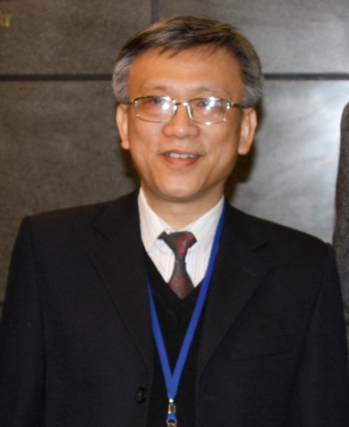
New Member of Steering Committee
Tsai Quang Vinh, Vice Director, Institute of Information Technology

Slide 6

Membership
University of Hong Kong
  Application Accepted

Slide 7
Future Meetings
Planning for Future Meetings
Possible Scenario
  Tsukuba
  Changchun
  San Diego

Slide 8
Future Directions
Challenges
  Data
Opportunities
  Virtualization
  VOMS
  GLEON – GEO – Telescience
  Avian Flu/Infectious Diseases and Data
Interesting New Area
  Cultural Heritage

Slide 9
Challenges/Opportunities for Next Meeting
Driving demo from working groups
  Pairs of working groups
Cool Things

Slide 10
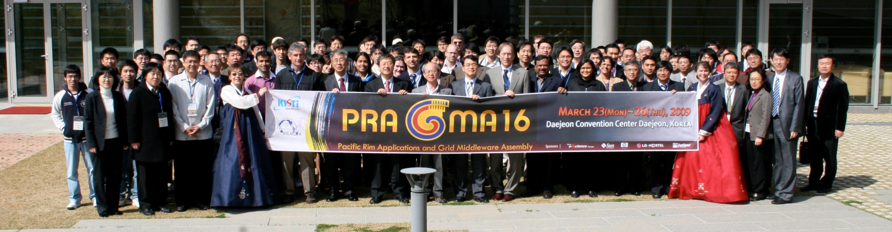


Thank You

